Slide 1


Introduction to
Harm Reduction

Slide 2
What is Harm Reduction?
A set of practical strategies and ideas aimed at reducing negative consequences associated with drug use

Slide 3
What is Harm Reduction?
Reduce spread of preventable diseases
Provide clean and safe supplies to reduce risk associated with substance use
Programs that impact the community as a whole
Notes:
-clean supplies means less complications for people who enter recovery, less burden on system – preg tests, first aid kits, condoms, feminine hygiene products
-safe sharp disposal, overdose reversal, education, testing

Slide 4
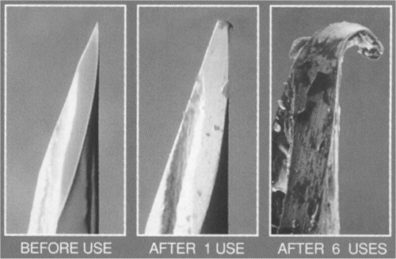
Harm Reduction at HCPH
Syringe Services Program
  Provide access to sterile supplies to help prevent the spread of preventable diseases
  Provide access to additional services such as vaccinations and testing
  Education and referrals to recovery centers
Safe Syringe Disposal
  Working with partners to place disposal boxes in community
Notes:
-New syringes and supplies also help to reduce abscesses and infections
-Safe disposal locations inside and outside to provide for safe disposal of potentially hazardous materials

Slide 5
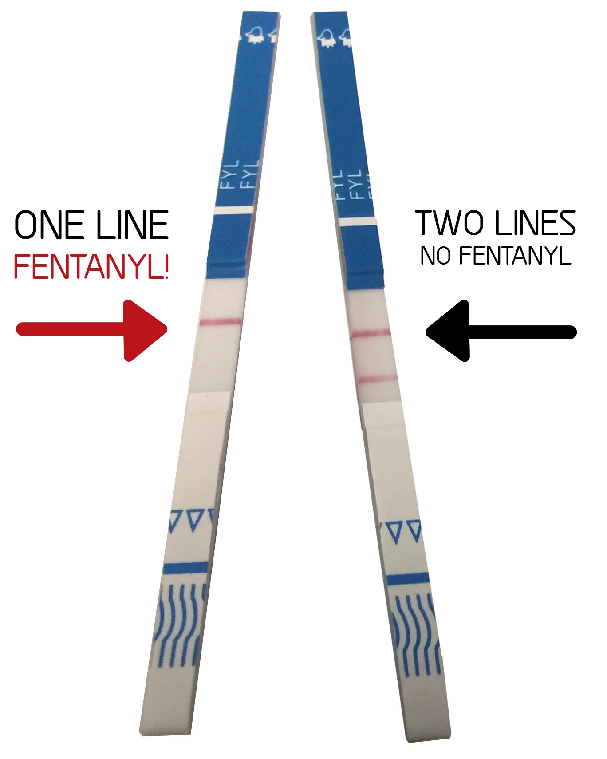
Harm Reduction at HCPH
Fentanyl test strips
  Distributed throughout the county
ACES and Trauma Informed Care
  Provide understanding to people who have experienced trauma and how it effects their lives
Organizational Collaboration
  Work with stakeholders in Hamilton County to collaborate efforts to address the opioid crisis
Notes:
-ACES – adverse childhood experiences
Examples – Physical or mental abuse or neglect, divorce or separation or parents, loss of parent, ect…
-test strips used to detect presence of fentanyl in non-opioid substances
-People with more traumas are at higher risk of substance use
-Healthcare meeting, OFR, steering committee for region, ATC

Slide 6
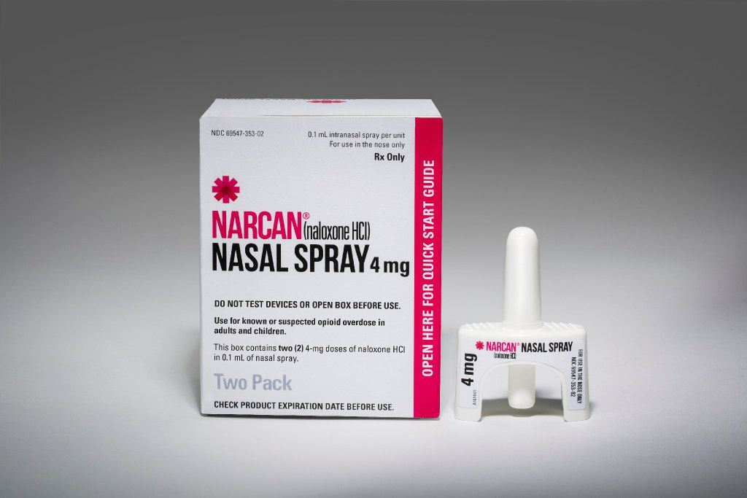
Harm Reduction at HCPH
Naloxone Distribution
  Providing life saving naloxone to organizations and members of public
Quick Response Team (QRT)
  Home visits to persons who recently overdoses
  Provide resources, linkage to treatment
Notes:
-Naloxone, keep people alive until they are ready and able to seek treatment

Slide 7

Harm Reduction at HCPH
Peer Recovery Support
  Peer Support Certifications
  Workforce development
  Support in Recovery
Community Support Program
  Harm Reduction Specialist
  Linkage to care
  Referrals
Notes:
-Naloxone, keep people alive until they are ready and able to seek treatment

Slide 8
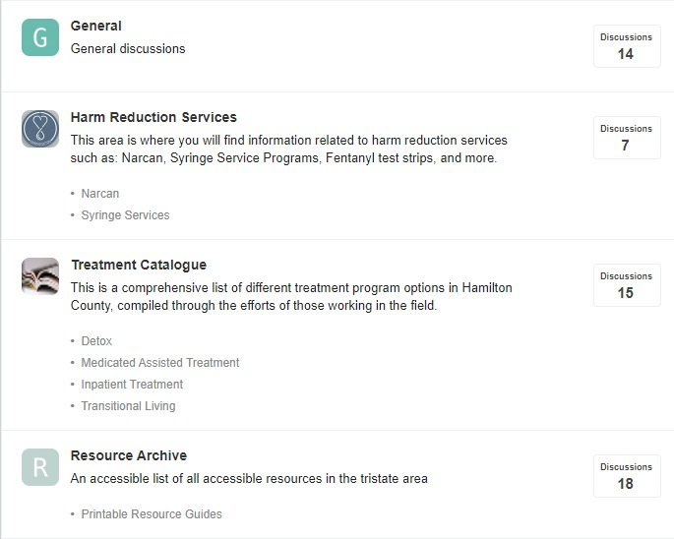
Harm Reduction at HCPH
Use of Technology
  App development
    HCPH
    Overdose Rescue
  Online forum
  Text notifications
Notes:
-Naloxone, keep people alive until they are ready and able to seek treatment

Slide 9

How can we help?
Provide a safe space for patients to speak freely
Approach patients with compassion and understanding
Provide information and resources
Use People first language
Notes:
-Maintain a positive attitude and be supportive when patients talk to you.
-Provide resources and information on treatment if the patient shows a willingness to enter recovery, not everyone will be ready.
-the more points of contact that are made in a supportive manor, the more willing a patient will be in the future.
-People first- Person suffering from addiction, not Addict. Not labeling people based on their diagnosis.
-Help to fight stigma and negative attitudes among staff

Slide 10
Local Resources
Harm Reduction Services
Syringe Services Program
513-316-7725
www.hamiltoncountyhealth.com/exchange
Narcan Distribution
513-946-7676
www.hamiltoncountyhealth.com/narcan
Testing Services
Hamilton County Public Health Disease Prevention
513-946-7611
www.hamiltoncountyhealth.com/hiv
Caracole
513-761-1480
www.caracole.org
University of Cincinnati Early Intervention Program
513-584-0720
Testing done at UCMC Emergency Department

Slide 11
Local Resources
Help Lines
Recovery Health Access Center
513-281-7880
Mental Health Access Point
513-558-8888
Talbert House Crisis Hotline
513-281-CARE(2273)
Recovery Support
Celebrate Recovery
www.celebraterecovery.com
Narcotics Anonymous
513-820-2947
www.narcincinnati.org
SMART Recovery
www.smartcincy.com
AI-Anon / Alateen of Greater Cincinnati
www.al-anon.org
Additional Resources
Office of Reentry
513-946-4304
Services for those returning to community from correctional facilities
Veteran’s Services
513-946-3300
Department of Job and Family Services
513-946-1000
OhioMeansJobs
513-946-7200

Slide 12
Any Questions?
Hamilton County Public Health
Harm Reduction Division
Philip Graham, RN, BSN
philip.graham@Hamilton-co.org

